Slide 1

Twitter Data Analysis Pipeline
Ishita Sen
March 2022

Slide 2


Objective
Implement a fully-automated AWS Data Pipeline for storage and analysis streaming Twitter data
ETL process designed as –
- Extract : Twitter API
- Transform : AWS Glue
- Load : AWS s3
Reporting & Analysis through –
- Athena
- Quick Sight
- Sage Maker Notebook
** Note : This is purely a proof-of-concept and the use cases are extremely simplistic!

Slide 3



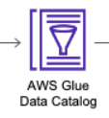













Design Diagram
Fetch Twitter API dev creds
Athena
1
8
9
User Type 1 : Data Analysts
Direct connection to Athena
Fires SQL queries
Data gather lambda gets streaming data from API
Processing S3 bucket
2
3
7
Glue crawler and Catalog
For POC
On-demand run for Crawler
Creates schema for querying processed data
Used by Athena
10
Quick Sight
Kinesis Firehose handles the streaming data.
For POC :
- Manual invoke
- Lambda runs ~ 3 mins
- Kinesis buffer size = 1 min
6
User Type 2 Executives
Connect through Quick Sight
Reports, Self-Service BI
KPI and decision making
End of day batch processing to collate data
- Lambda triggered by CRON exp
Kicks off Glue job
Glue : ETL, extract relevant columns
Incremental Load for previous day from Staging to Processing Bucket
Keeps the same partition for staging
If job runs twice a day, does a flush and fill for that day
Twitter v2 dev API Filtered Data stream
4
Sage Maker
Athena Query Results S3 bucket
Tags used for Filter
Covid, Ukraine
5
Staging S3 bucket
Saves raw streaming data
Partition by – yyyy/mm/dd
User Type 3 : Data Scientists/ML Engineers
Jupyter Notebook through Sage Maker
Model Building
Prediction

Slide 4
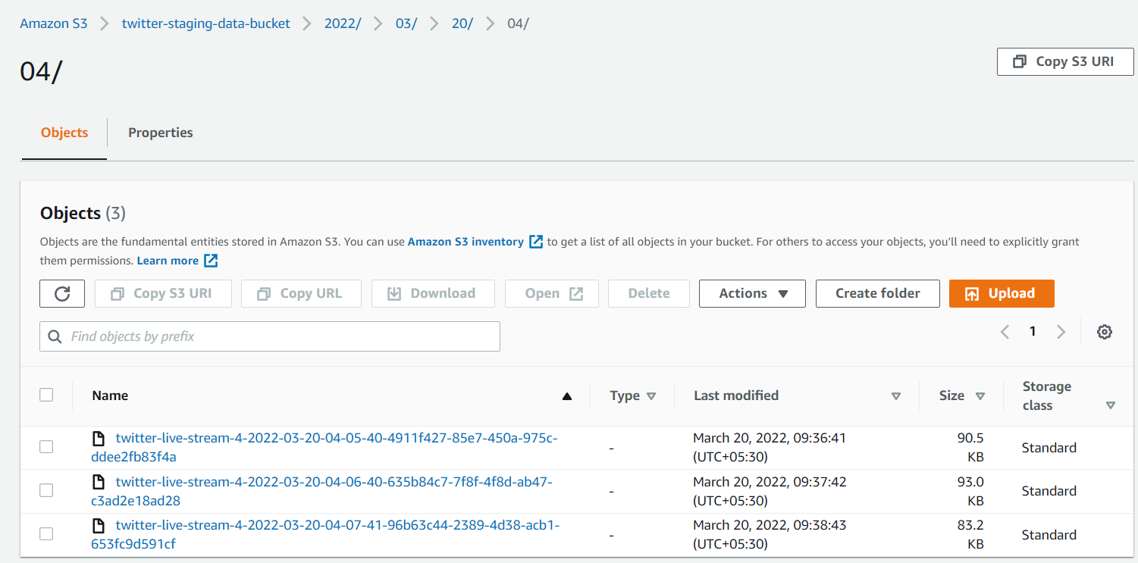
Data Snippets - 1
Staging bucket containing partitioned streamed data
output from Kinesis Firehose
Single streamed raw record – Data + Metadata
{
"data":{
"created_at":"2022-03-20T04:05:29.000Z",
"id":"1505395074414219267",
"text":"@RichardHanania \u201cThe cost of Ukrainian winning a Nobel Peace Prize, maybe.\u201d"
},
"matching_rules":[
{
"id":"1505395102490849281",
"tag":"ukraine"
}
]
}

Slide 5
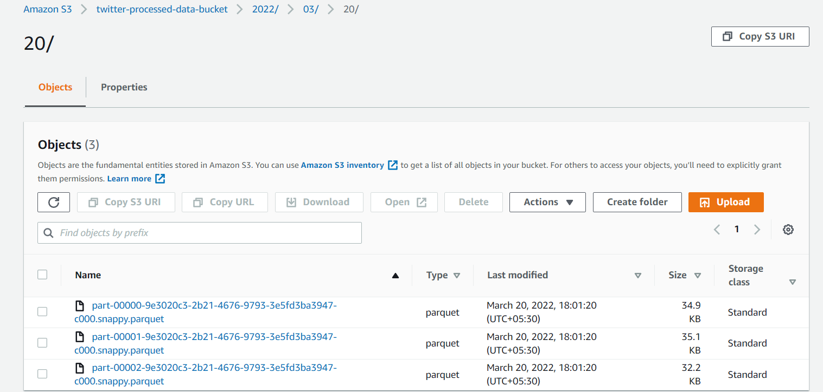
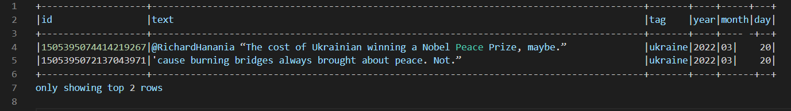
Data Snippets - 2
Processing bucket containing flattened data in compressed parquet files
Processed data record (contains selected fields only)

Slide 6
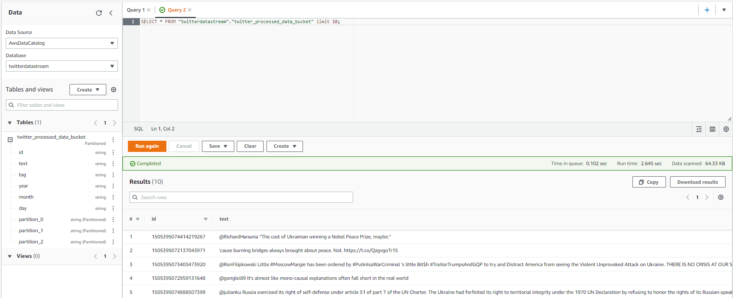
Athena Query Output

Slide 7
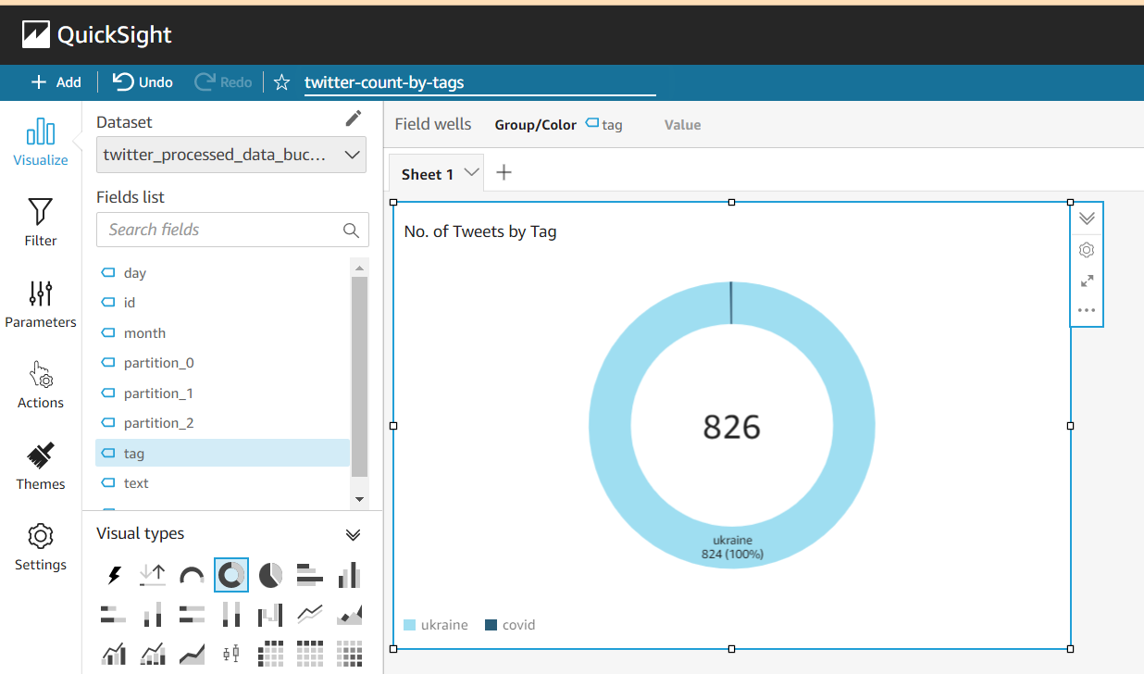
Quick Sight Report Sample

Slide 8
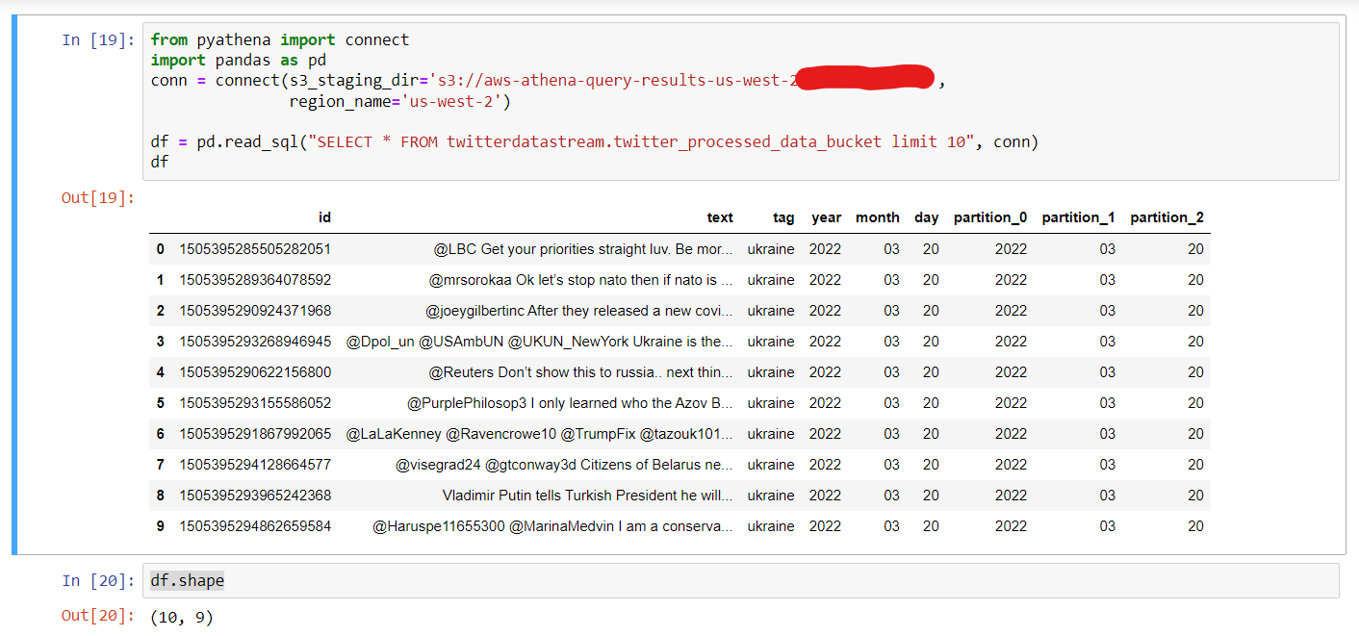
Jupyter Notebook Setup Query

Slide 9
POC Considerations and Enhancement Scope
Data Streaming Lambda runs on-demand for 3 minutes
- used for demo-purpose only
- would need alternative streaming sources for enterprise use-cases
Encryption is limited
- currently only for s3 and Secrets
- would want to cover all resources
Athena used for POC
- since the use case was very simplistic
- would target using Redshift Spectrum in a production environment since it can handle larger volumes at same price
Glue Crawler is on-demand
- can orchestrate the Lambda invoke + Glue job + Crawler through a step function for nightly execution
VPC and subnets
- In the POC setup Glue jobs run on default VPC
- The s3 endpoints have been created in the VPC and subnet
- a NAT gateway has also been established
- would need to put lambdas inside VPC
Resource Provisioning and Set-up
- for POC, all resources were created through console
- for project-level implementation, would recommend using Infrastructure as Code

